Slide 1
Data preprocessing of analyzing outliers

Slide 2
Data Science Experiment Flow
Data Pre-processing
Testing
Data Collection
Training
Result Analysis
(Regression)

Slide 3
Task Introduce
A factory machine efficiency analysis problem.
Without any label data and reasonable operation range
Target : analyze data to find out the cause.

Slide 4
Task Introduce
But! Before starting to analyze, we know that outliers is largely influence the regression result.
It is obvious that hand-pick outlier not a good option, so we use some machine learning algorithm to find outliers.

Slide 5
Algorithm | Base on
Box | Statistics
ABOD | Angle-base
CBLOF | Clustering-based
IForest | Ensemble
Feature Bagging | Ensemble
Combine some weak classifier to become a strong classifier

Slide 6
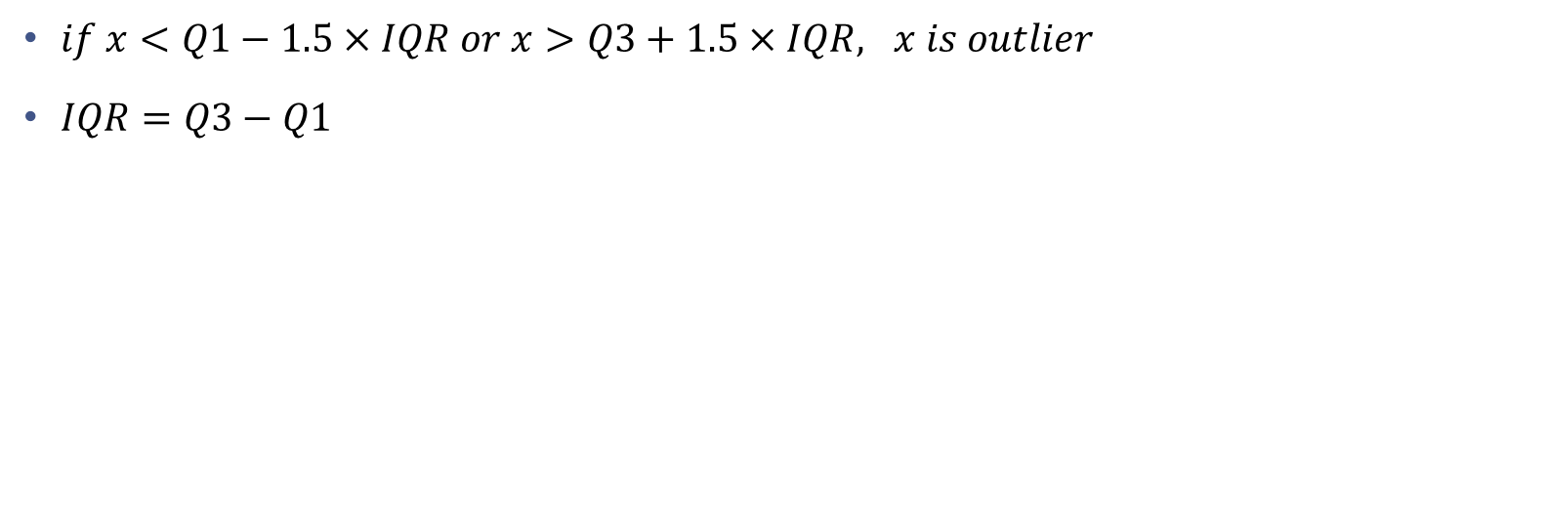
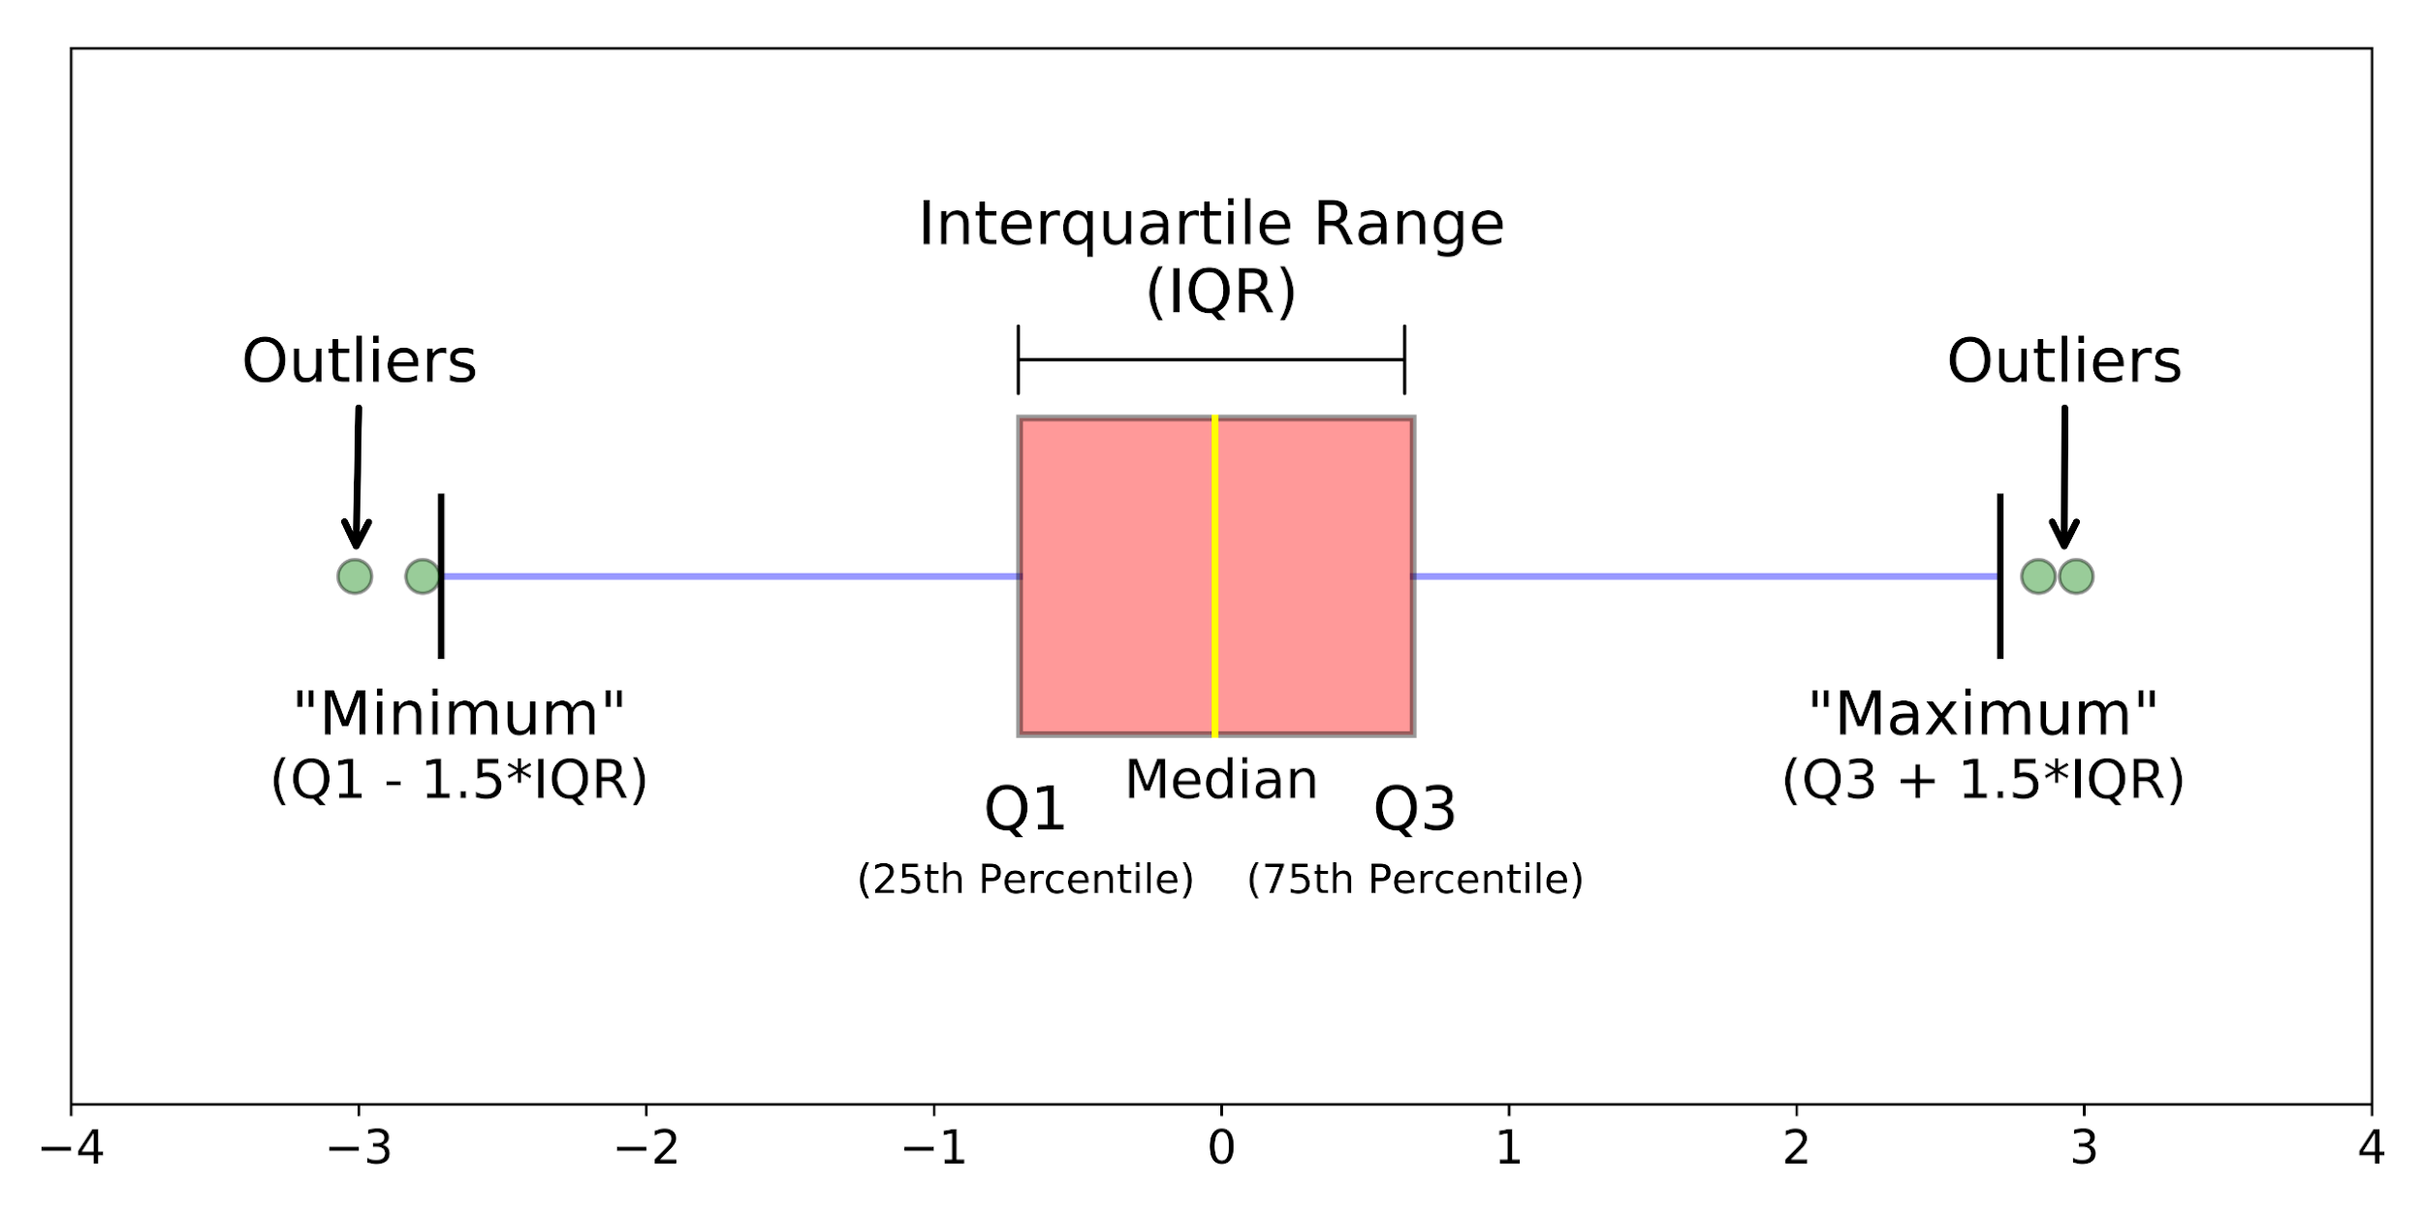
Box

Slide 7
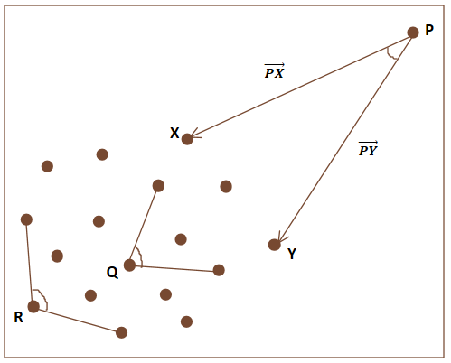
ABOD
Angle-based
The performance is more stable than distance in high dimensional
In the right graph, the variance ( of all the possible angles to rest of the data points) for the farthest data point P will be lesser as compared to the nearer data points. Thus the data point with less variance of angle will be considered as an outlier.

Slide 8
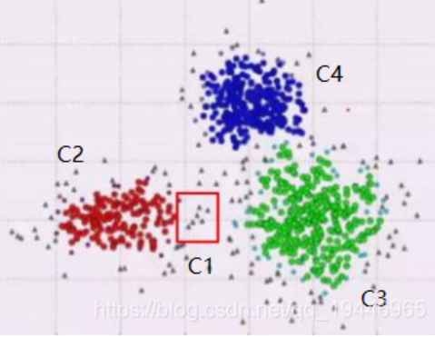
CBLOF
Clustering Based Local Outlier Factor
When a point is closer to a large cluster, the probability of it being a normal point is higher. Then, we will use k-means algorithm to cluster data in CBLOF. So, we have the four clusters in the right picture. Here, we can clearly see that C2, C3, C4 are three large clusters, and the remaining C1 is a small cluster. Then, the closer it is to the center of C2, C3 or C4, the more normal it is, and vice versa.

Slide 9
KNN in PyOD(NearestNeighbors)
The traditional KNN is a supervised algorithm, and the data must be labeled in advance. Here we use the KNN algorithm in PyOD, which is a scalable Python toolkit for detecting outliers in multivariate data. After checking the code content of the PyOD KNN algorithm, it uses the NearestNeighbors method, which is different from the original KNN, this is an unsupervised algorithm.
Because our data are without any label data and reasonable operation range, we can’t use supervised algorithm.

Slide 10
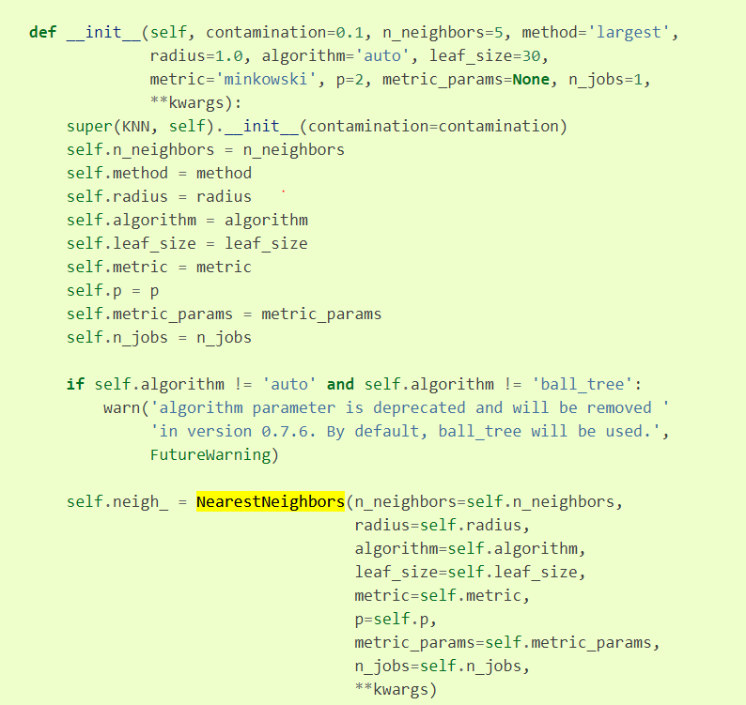
Part of Source code for PyOD.models.knn

Slide 11
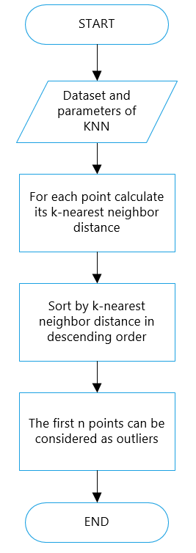
Flow chart of outlier detection based on KNN algorithm

Slide 12
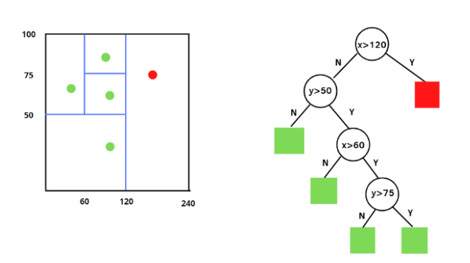
Ensemble
Iforest
Use multiple independent trees to train.
Result use average of each tree score.

Slide 13
Ensemble
Feature Bagging
Randomly draw and put data back
Train each weak classifier,
Result is determine by voting.

Slide 14
How to evaluate
Each of algorithm base on its rule ( XXX-base) to give their result…
We need a way to judge whether the results are good or bad
Our proposal is
Calculate the distance between each data(Compare each data with other n-1 data)
Sort from small to large.
Calculate the average, variance, max and min.
(Outliers with outliers ; Inliers with inliers)

Slide 15
Detailed steps
Determine how many percent of the data to filter, and set the contamination (representing outlier_fraction) of the algorithm in PyOD
If we have data 1, 2, 3, 4, 5, 6. The Iforest, KNN, CBLOF, will first generate their own outliers and non-outliers ((outlier), (non-outlier)), such as: ((1,2,3),(4,5,6)), ((1,3,5),(2,4,6)), ((1,2,4),(3,5,6))
Calculate the distance between 1 vs 2~6, 2 vs 1,3,4,5,…, 6 vs 1~5 and sort the distance in ascending order
When calculating the indicators (avg, std, etc.), the first outliers calculate the indicators together, and the second calculate the indicators together..., and the same for inliers
Finally we can judge whether the various algorithms are good or bad

Slide 16
Take result of Iforest for example
Sort the distance in ascending order
vs | 1 | 2 | 3 | 4 | 5 | 6
1 | 0 | 3 | 2 | 5 | 7 | 6
2 | 3 | 0 | 8 | 9 | 7 | 4
3 | 2 | 8 | 0 | 5 | 9 | 9
4 | 5 | 9 | 5 | 0 | 6 | 8
5 | 7 | 7 | 9 | 6 | 0 | 3
6 | 6 | 4 | 9 | 8 | 3 | 0
Avg
Outliers | 1 | 2 | 3
 | 2 | 3 | 2
 | 3 | 4 | 5
 | 5 | 7 | 8
 | 6 | 8 | 9
 | 7 | 9 | 9

Slide 17
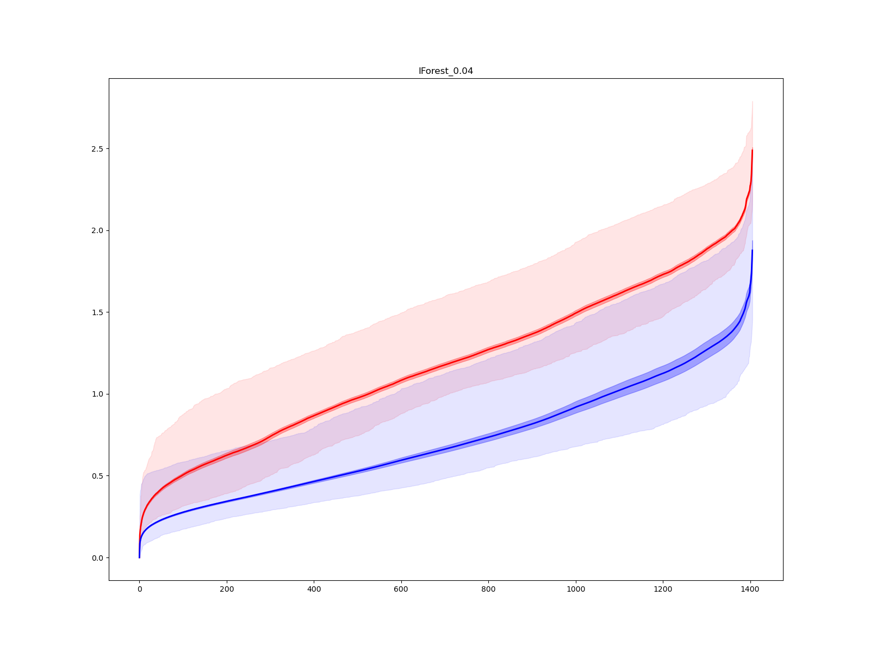
Outlier
Inlier
Average of Distance for all point
Average of their distances to the 200th for all inliers (each with its own 200th rank of the 200th closest, average the values as in the last slide)
Average of Distance for all point

Slide 18
Outlier
Variance of Distance
(Dark shadow)
Max Distance to each point for outlier point.
Inlier
Min Distance to each point for outlier point.
Max Distance to each point for inlier point.
Min Distance to each point for inlier point.
Variance of Distance
(Dark shadow)

Slide 19
Analysis : Outliers
Outliers have low variance and high average than inlier.
Outliers are scattered or just some small clusters and far from inlier.
So each of outliers has a large distance which make average high and low variance.

Slide 20
Analysis : Inliers
Average of inlier is far from outlier, that is good.
Max of distance of inlier is lower than average of outlier
🡺 Inlier and outlier is very separate.

Slide 21
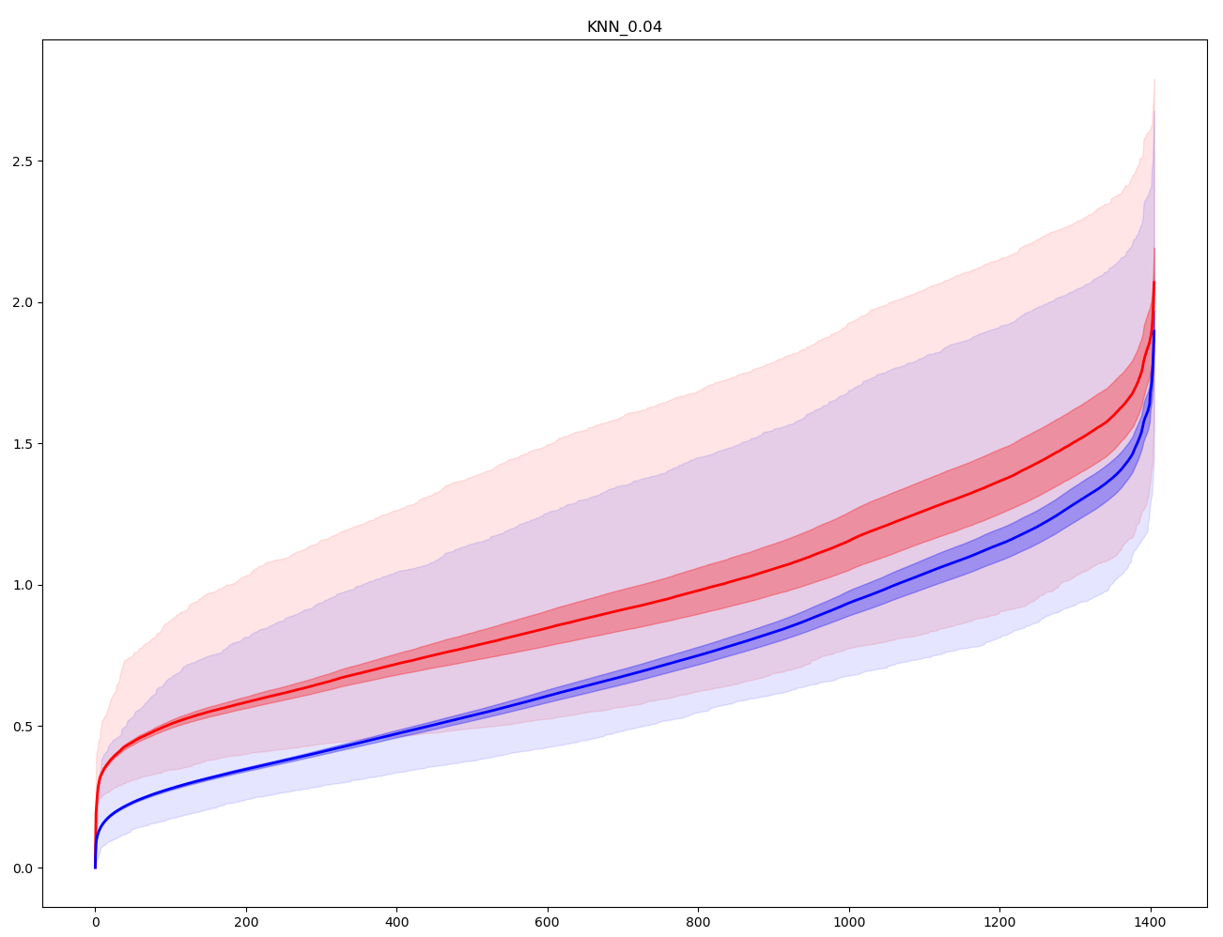
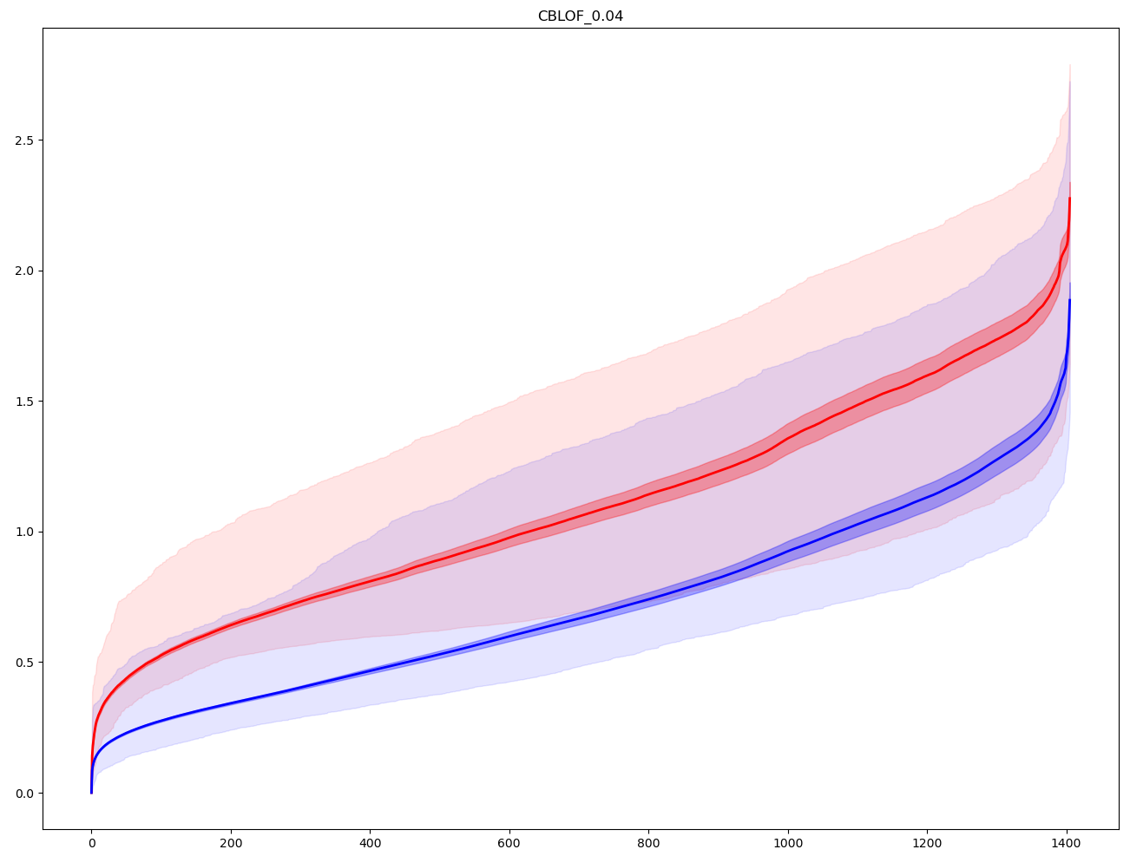
Compare
IForest
kNN
CBLOF

Slide 22
Conclusion

